Slide 1
Introducing the picozero Library

Slide 2
Using Thonny to download and install picozero Library
Introducing picozero documentation
https://picozero.readthedocs.io/en/latest/recipes.html#importing-picozero
Recipe
API

Slide 3
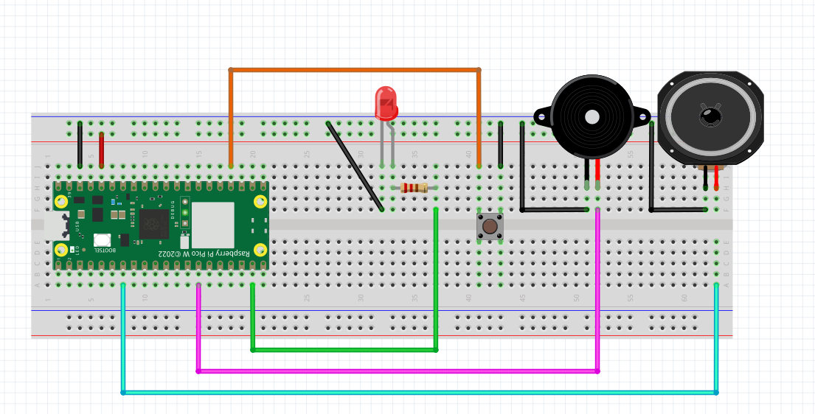
Testing the picozero Library
LED Button Buzzer Speaker

Slide 4
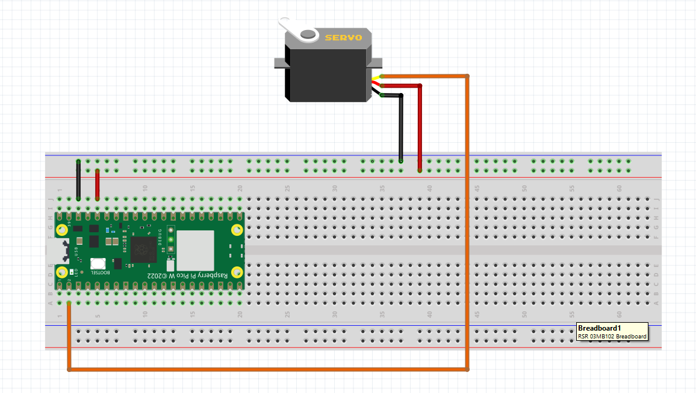
Testing the picozero Library
Servo

Slide 5
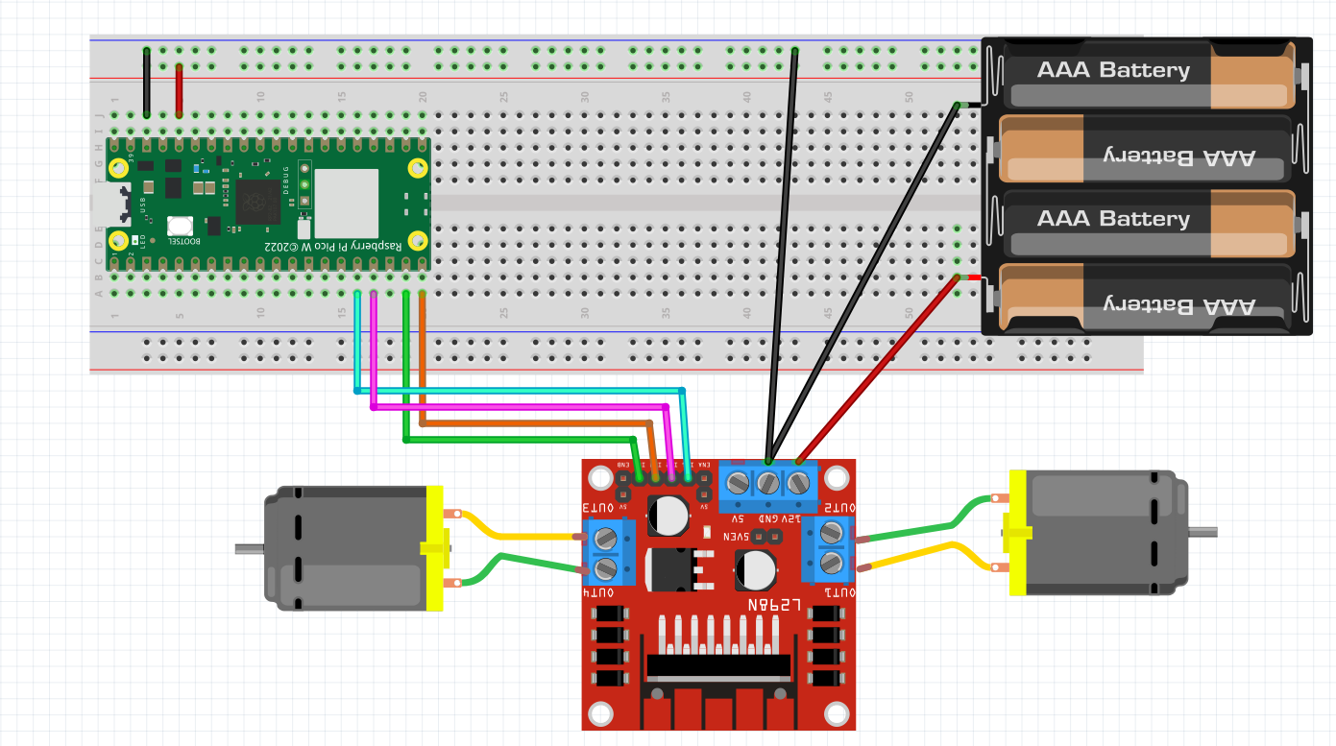
Testing the picozero Library
Motor / Robot

Slide 6
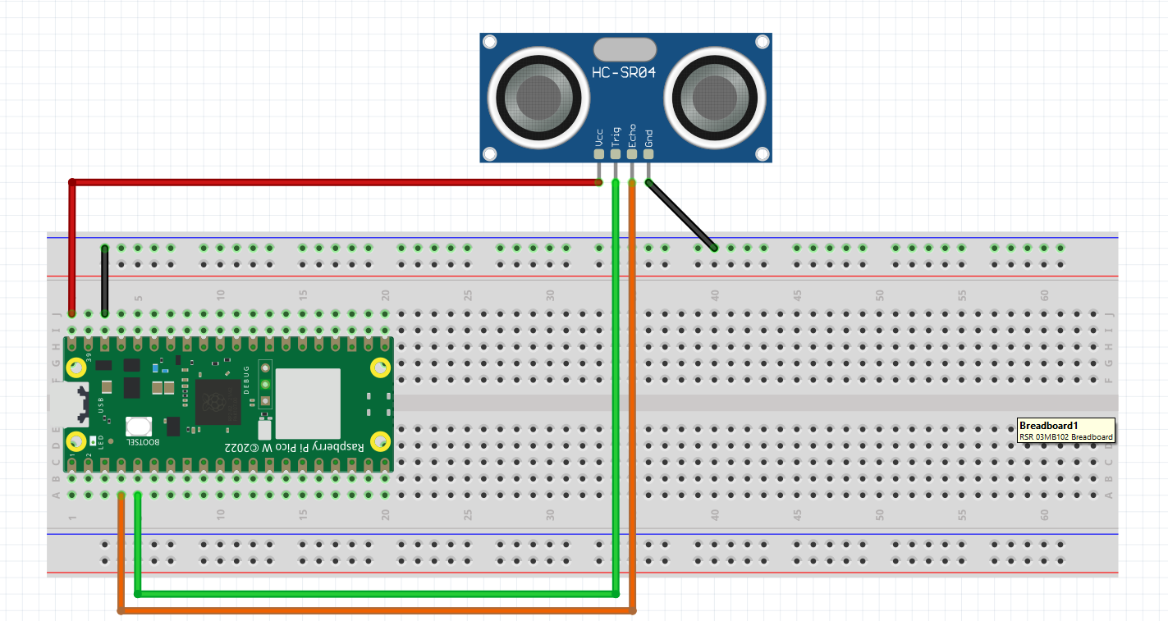
Testing the picozero Library
DistanceSensor
VBUS

Slide 7
RUNNING PICO UNTETHERED TO LAPTOP
Save program as main.py
Use power bank to power Pico

